Slide 1

BY: YARIV LEVY, RONIT PRIAV, OVED HARUVI & DORON KOPIT
DATA-CENTERED CROWDSOURCING WORKSHOP - SEMESTER B, 2020/2021 - TEL AVIV UNIVERSITY
INSTRUCTORS: DR. SLAVA NOVGORODOV, KATHY RAZMADZE

Slide 2
What is ReadMe?
ReadMe is a crowd-sourced web app that helps users explore the news
Consists of 2 main parts:
Chrome extension - Accompanies the user while reading online
ReadMe Dashboard - Centered platform for news consuming and advanced features

Slide 3
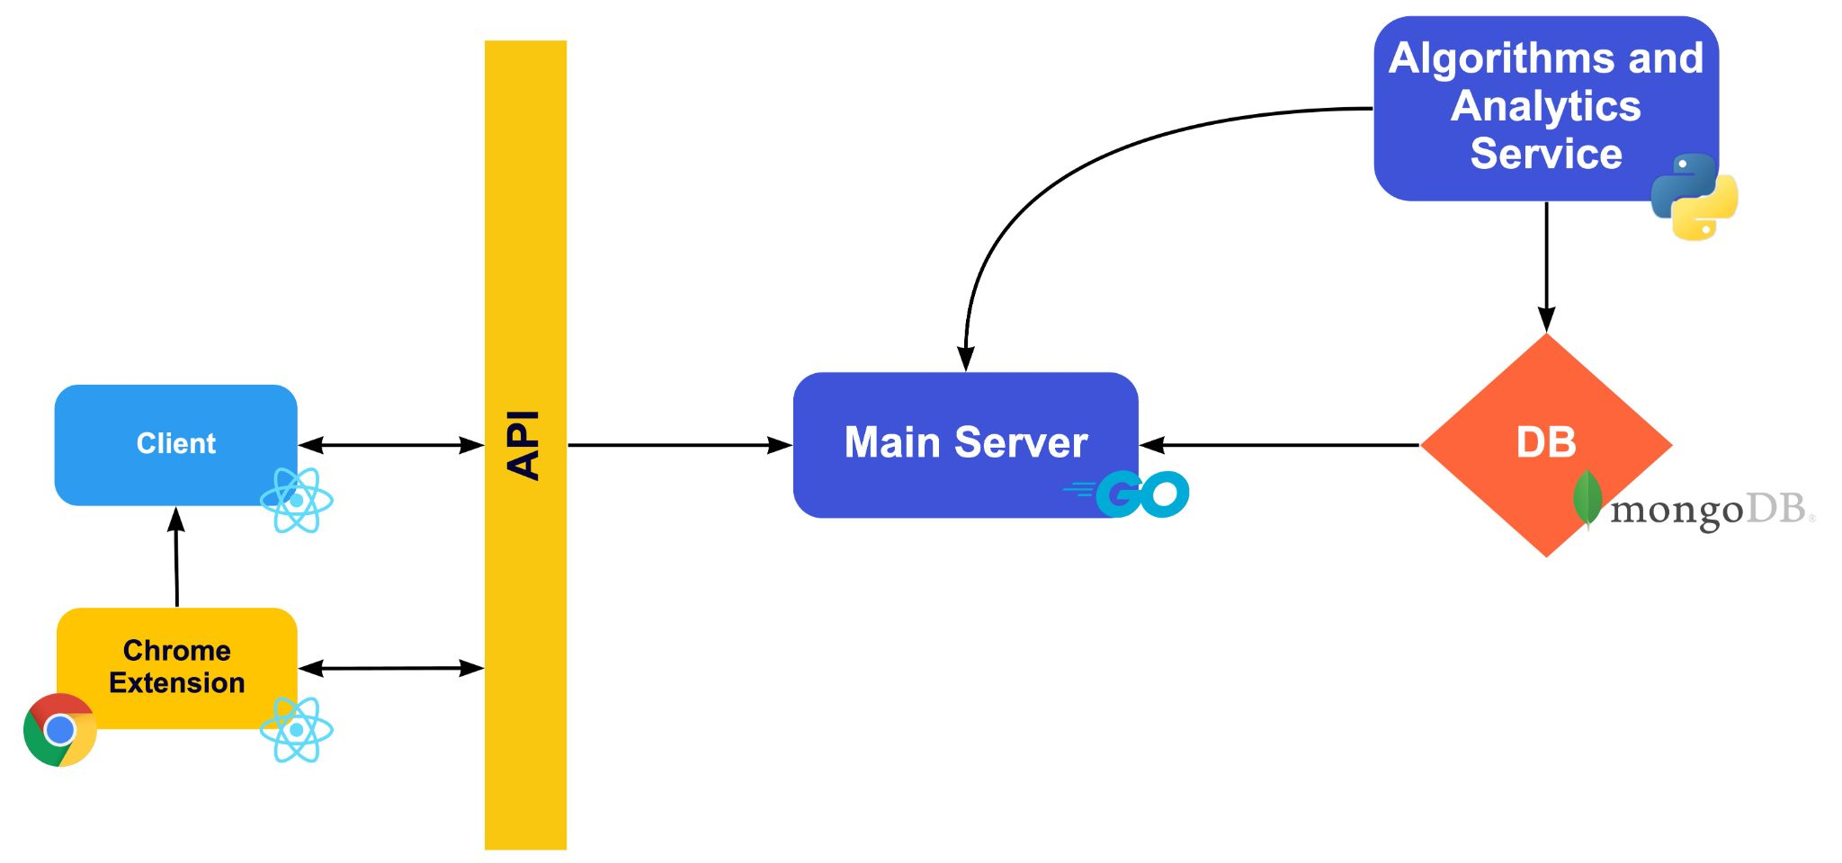
Architecture

Slide 4





Architecture
Used Python, React, Golang as tech stack
Used MongoDB as dbms
Used GitHub as version control
Used Docker for plug-and-play capabilities
Used Azure as host

Slide 5
The Crowd's Role
In ReadMe Chrome extension:
Users add new articles to the database while browsing the web - actively and passively
Users submit tags for articles.
In ReadMe Dashboard:
Users vote for the reliability of articles they browse through in the website
Users answer requests other users submitted about articles
Users vote for the best answer for a request
Notes:
What if users vote without thinking?- The reliability calculation, based of the score, dynamically calculates a ratio and ratio-threshold of the votes for all the articles shown, making several random votes not count if they stray from the general decision of the crowd.

Slide 6


User Incentive
Score System-
Every user starts with an initial credit upon signing up to ReadMe
When completing actions that enrich the crowd-sourced data the user gains points
When a user gains enough points they become a premium user
Notes:
What if a user votes randomly on articles to get score?- Score gained from voting is relatively little so to get an impactful score change the user will have to work hard. In addition to that, a further implementation to the score system could be to nullify the users' score in the end of each month thus ensuring that users will keep taking part in the crowd sourcing to gain the premium benefits.
An algorithm we thought about but choose not to implement in this time period- In the end of each month the scores will normalize and lower for all users to encourage the incentive and keep users from gaining ridiculous amounts of scores.

Slide 7


User Incentive - Premium Users
Unlocked Options-
Can watch data analytics inferred from the crowd-sourced data
Can request knowledgeable users to answer questions about articles

Slide 8

Data
Used News_Dataset from Kaggle for articles (+ some manual additions)
Generated synthetic data for users, requests, answers, reports, ...
Generated requests and answers using GPT-2 variants
The system contains:
~2200 articles
~500 users
~7700 favorites
~700 requests
~1100 answers

Slide 9
Live Showcase!

Slide 10


Slide 11
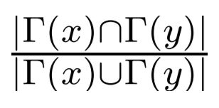
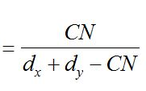

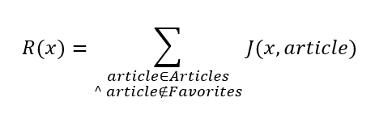


Algorithms - Recommendations
Problem - Given user X choose N articles.
Solution:
Based on Favorites DB Collection
Bi Partite graph where Users & Articles are nodes, favourites are edges
If enough Data: Aggregate Jaccard (Next slide)-
Else: Generic recommendation using degree centrality measure -
-- Neighbours of node x
R(x) -- Recommend score
Notes:
Currently based on Favorites -
Small note about favorites collection
optimal is to take into account any interaction with an article.
We used favorites because it was convenient and showed the idea of the algorithm good enough.

Slide 12
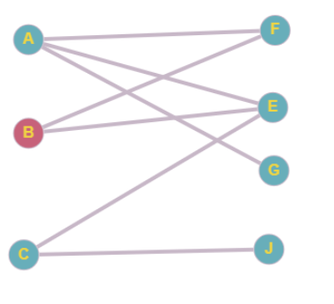
Algorithms - Recommendations Aggregate Jaccard
For each Article that not in favorites -
Compute the jaccard coefficient to all favorite articles
For each Article that not in favorites -
Sum the coefficients
Return top n articles by aggregated result
Users
Articles
Notes:
Jaccard coefficient of x and y is the intersection divided by the union of x and y.
Compleixity- m is the number of favorite articles, n is the number of articles.
Space - O(Users + Articles + Favourites)
Time - assume m << n and J(x,y) can be computed in O(1) by caching the result ---> O(n)
Centrality- O(n)

Slide 13
Algorithms - Recommendations Example
Users
Articles
We will recommend for B
B liked F & E articles
Compute :
J(F, G) = 1/2
J(E,G) = 1/3
J(F,J) = 0
J(E,J) = 1/3
R(G) = ½ + ⅓ = ⅚
R(J) = 0 + ⅓ = ⅓
Hence - We will prefer G over J

Slide 14
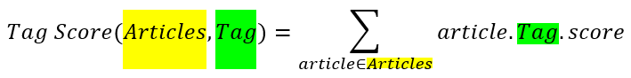


Algorithms - Request routing
Problem - Given user X offer the most “relevant” requests
What is relevant?
Solution - Tag based
Compute User tags
Choose requests regard articles with largest intersection set between tag set to user’s tag set
Notes:
What is Relevant?
We want to show the requests with the highest chance thatr the user will know the answer to.
The approach -
base on his Favorites (Same as Recommendation - optimal is to use every interaction)
Example -
User really into gaming so it’s reasonable to assume that technology, keyboards, games will appear in his UserTags.
The article “Best keyboards for gaming 2021” will probably have those tags then UserTags and articleTags will get Big Intersection set relative to other articles hence we would like the user to see request regard the this article.
Complexity -
O((Users Favorite + Articles Tags) * Articles) → O(Articles)

Slide 15
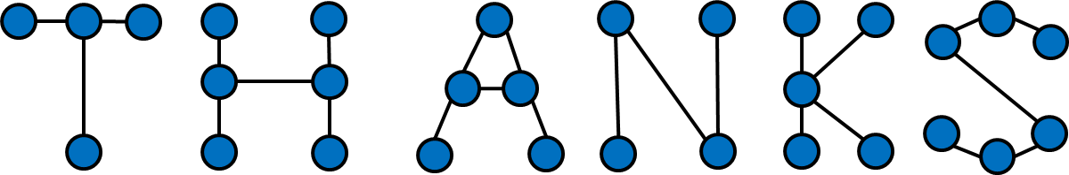
You can join us at : http://readmeproj.online
Check out our https://github.com/ReadMeProj/ReadMe

